Slide 1

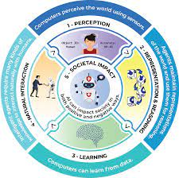
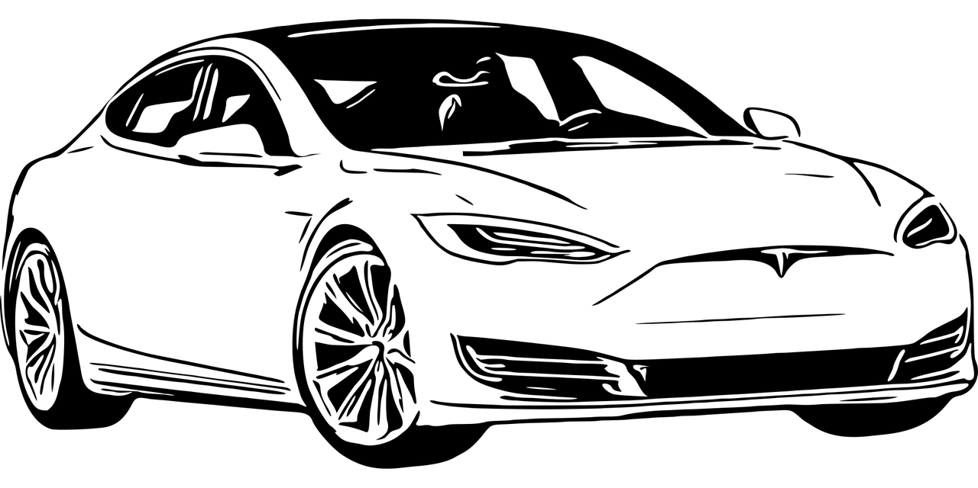


Artificial Intelligence for GA
Unit 1 - Autonomous Robots & Self-Driving Vehicles
Daily Assignments: Module 1.1 - Living and Working with AI Slides Nearpod Link Module 1.2 (A) - Robot or not Slides Pear Deck Module activity to complete Autonomous Robots Activity 1 Dream Bot - Ticket Out the Door (Slide 2) Module 1.2(B) Autonomous Robots Slides Module activity to complete Autonomous Robots Activity 2 Dream Bot - Ticket Out the Door (Slide 3) | 4. Module 1.3 (A) Anatomy of a Self-Driving Car Slides Nearpod link Module activity to complete Self-Driving Cars Dream Bot - Ticket Out the Door (Slide 4) 5. Module 1.3 (B) Anatomy of a Self-Driving Car Slides Module Activity to complete Self-driving Cars Blooket - Module 1.3 Review Dream Bot - Ticket Out the Door (Slide 5) | 6. My Dream Bot - Ticket out of doctor Slides Imagine your robot This activity is designed to help students make connections across the modules in Unit 1. We've added slide at the end of each one of the decks in this module and provided preview on this site to help you plan your activities for the day. In this activity, students will envision a robot that solves a societal problem they care about. After each module, they will add more details about their robot and how it works based on the main concepts presented in the module. Implementation: Each student should make a copy of the slide deck and use it to incrementally work through the slides building their bot. If students need some support with designing the physical structure of their robots, they can give students the Imagine Your Robot slides. Preparation: You can design your own robot as a model that you can show students to help them see how they might make connections between the module's content and their robot. 7. Weekly Feedback Student feedback Teacher feedback
Developed for the AI4GA (Artificial Intelligence for Georgia) project funded by National Science Foundation awards DRL-2049029 and DRL-2048502.This work is licensed under the Creative Commons. Attribution-NonCommercial-ShareAlike 4.0 International License. https://creativecommons.org/licenses/by-nc-sa/4.0/

Slide 2
Artificial Intelligence for GA
Unit 1 - Autonomous Robots & Self-Driving Vehicles
Daily Assignments: Module 1.4(a) Perception Slides Module Activity to complete Create your robot Face Mesh Software: Face Demo (Browser -based app) Print Out: Test patterns Experiments Module 1.4 (b) Perception: Create Your Own Face Filter Slides Module Activity to complete Create your own face filter (Slide 20) Software being used Scratch Face Lab (web application) Module 1.5 Route Finding Slides Module Activities to Complete Route Finding Dream Bot - Ticket Out the Door (Slide 8) | . Module 1.6 Mini Project Slides Nearpod Module Activities to Complete Case Study: Sleeping Drivers in Self-Driving Cars Ticket Out the Door (Slides 9) End of Unit Project - My Dream Bot Slides Imagine your robot Case-Study - Self-Driving cars Slides Build Your Own Robot This activity is designed for students to extend the My Dream Bot activity into a polished end of unit project Suggestions: If students have completed the My Dream Bot activity as they worked through the unit, you can have them review their My Dream bot slides to see how they might refine the functionality of their robot. This can be done in pairs. If the student did not work on the My Dream Bot activity, they could do this first as a way to scaffold the their work in the mini-project. End of Unit Student Assessment

